Slide 1
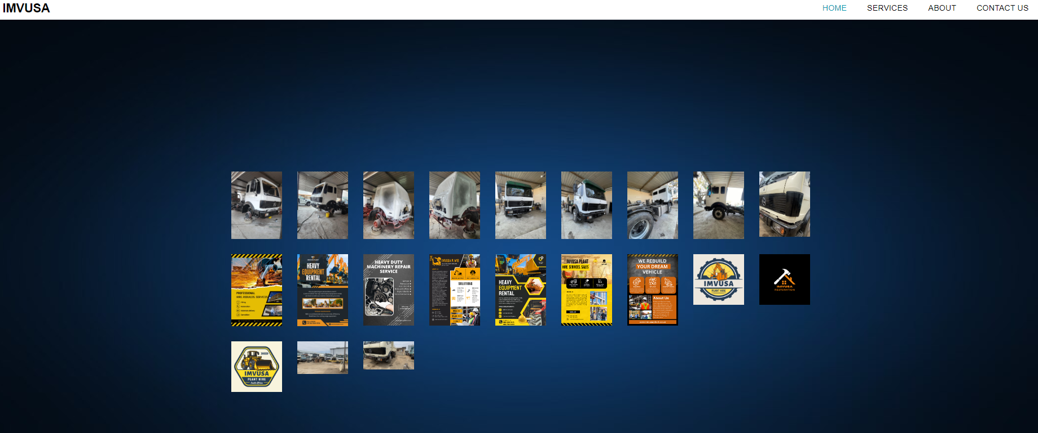
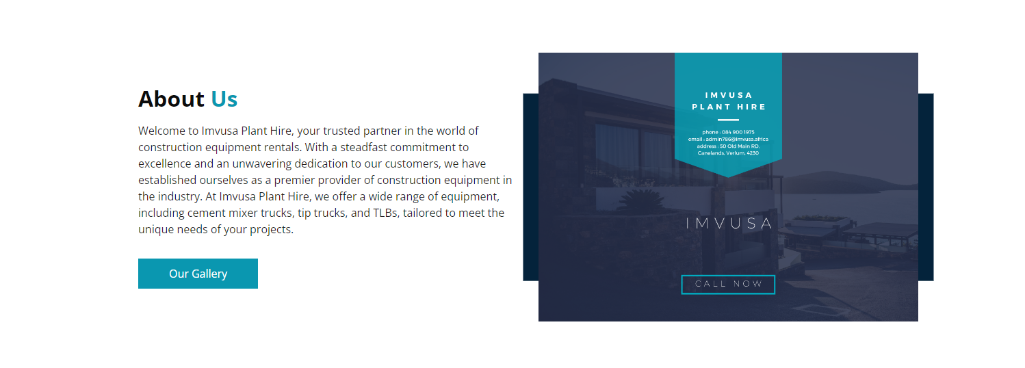
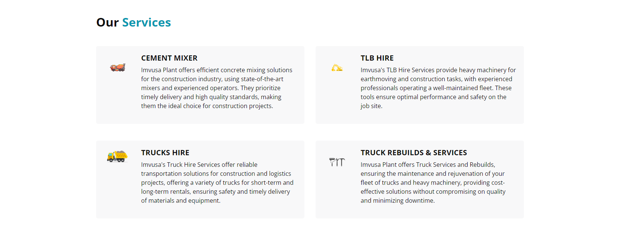
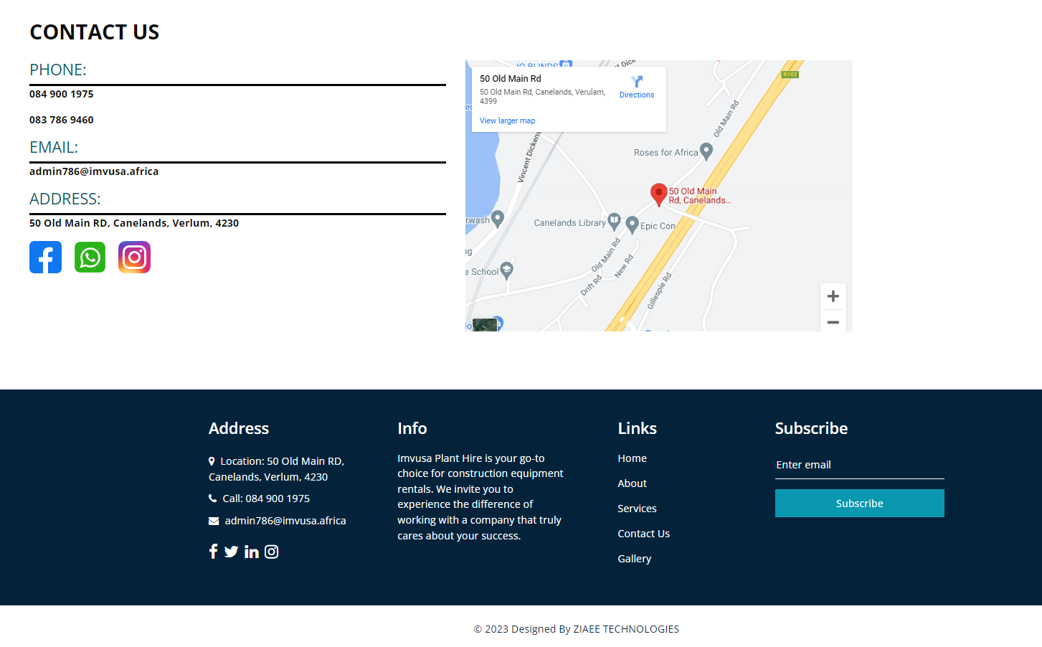
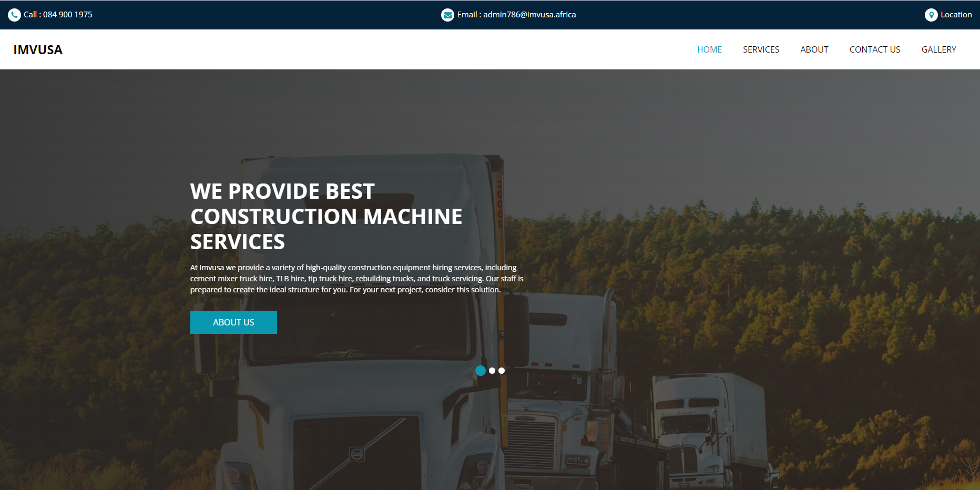

New Features:
HIRE US:
Empower customers to generate estimated quotes for hiring IMVUSA machinery, providing easier access to our offerings and ensuring prompt contact upon submission.
Gallery:
This platform will allow customers and end users to view photos of all our work and machinery, helping them to find the right solutions for their business needs
A secure administrative page will allow IMVUSA managers to upload and delete images
Home:
The home page will be revamped to include additional business information and services.
New CSS animations will enhance the visual appeal of the user experience.
New social media Api’s will be integrated to optimize contact with IMVUSA agents.
F
E
D
C
B
A
IMVUSA
IMVUSA Plant Hire is a leading provider of heavy-duty machinery rental and refurbishment services. They offer a wide range of construction equipment for rent, including:
Backhoes
tipper trucks
cement mixers.
Plant Hire
Their team of experienced and skilled mechanics provides their customers with the highest quality services possible.
They also offer a wide range of maintenance and repair services to keep equipment running efficiently and avoid costly downtime.
“Whether you need to rent heavy-duty machinery for a short-term project or have your existing equipment refurbished, IMVUSA Plant Hire is the perfect solution for you.
A company that offers refurbishing and hiring of heavy-duty machinery.

Slide 2
Thank You

